Slide 1
INFO 341 Converting Numbers
By
Bob Larson

Slide 2
Topics
It’s All Bits to the Computer
Putting Bits into Human Numbers
Not New, Just Different
10 Types of People

Slide 3

It’s All Bits to the Computer
Switch Off/On (0/1)
Millions & Billions per second
It is the pattern that matters
Commands and Properties
Labels
Addresses
Colors
Volume
Images
Music and Voice

Slide 4
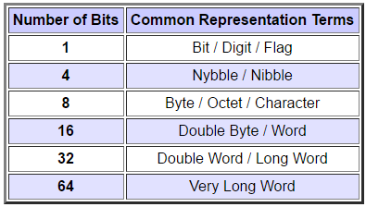
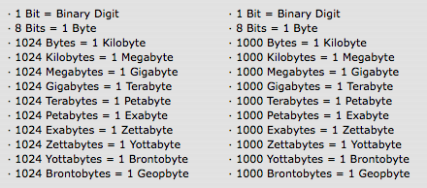
Putting Bits into Human Numbers
Different designations for different needs
Science vs Marketing*
1024 vs 1000 respectively
* Close enough in many cases
Bits vs Bytes
100 Mbps: b = bits
100 MBps: B = bytes (8x bits)

Slide 5
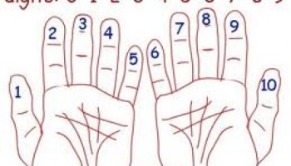
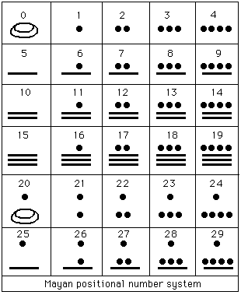
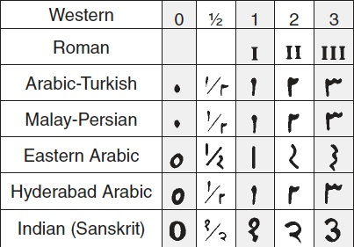
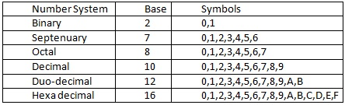
Not New, Just Different
Base-x = x unique digits
Base-10 our Decimal system
0,1,2,3,4,5,6,7,8,9
Base-2 Binary numbers
0,1
Base-16 Hexadecimal
0,1,2,3,4,5,6,7,8,9,A,B,C,D,E,F
Common formats:
#ff12ee
0x1234DE
9C-B6-54-EF-41-A4 or 9C:B6:54:EF:41:A4

Slide 6
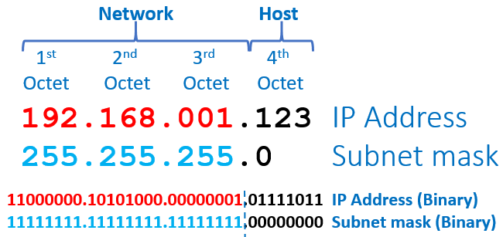
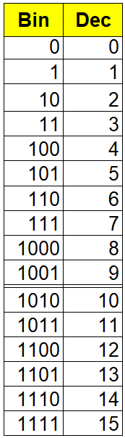
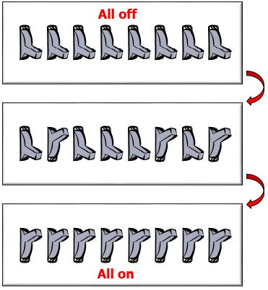
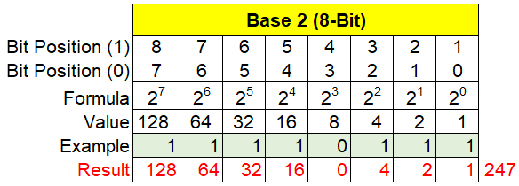
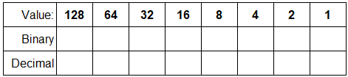
8-Bit Binary
Each Bit doubles the number of combinations
256 Unique Combinations (0-255)
In the real world

Slide 7
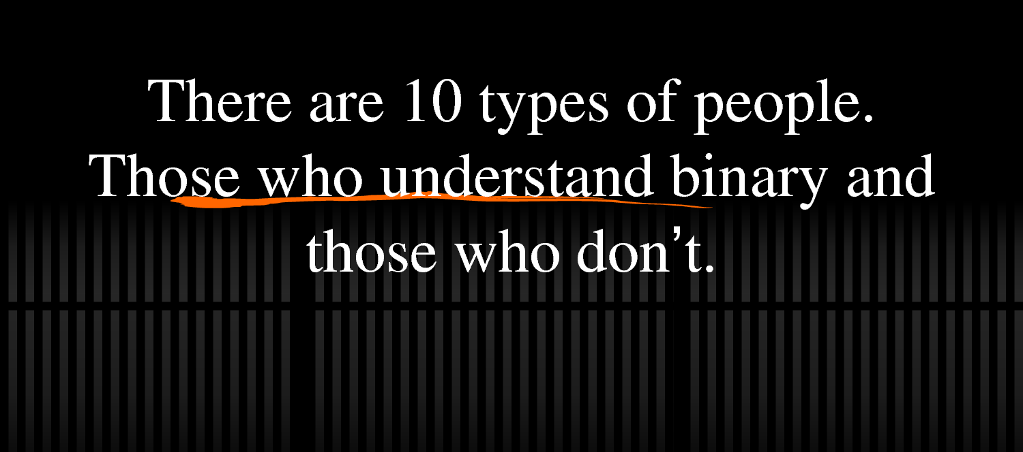
10 Types of People

Slide 8
Fin…

